Slide 1
Additional Features (Data Structures and Algorithm CA2)
Done By: Toh Kien Yu (P2222291)
Class: DAAA/2B/05
Group Number: 5

Slide 2
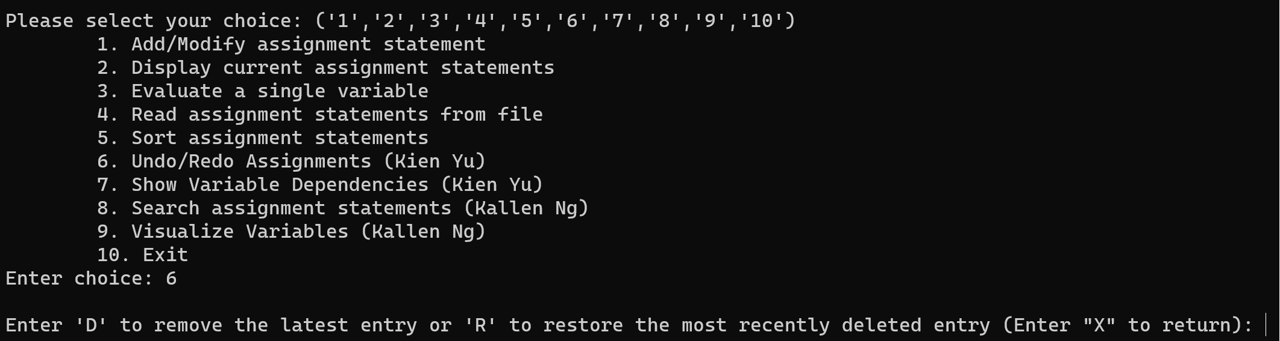
Additional Feature 1 (Redo & Undo Assignments)
The Undo & Redo Assignment option allows users to revert changes made to their assignment statements or restore them if needed.
This option allows for flexibility and allow users to manage their assignment statements more effectively, thus improving the user experience.

Slide 3
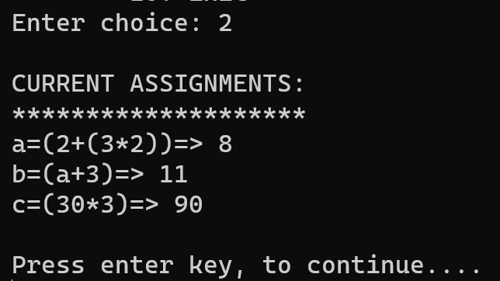
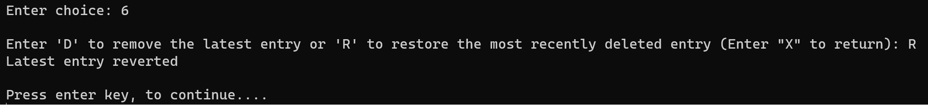
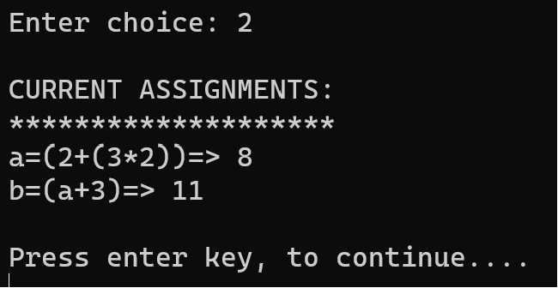
Additional Feature 1 (Redo & Undo Assignments)
Not only that, whenever the user makes a mistake and accidentally removes an assignment statement. The user can easily restore it by using the redo feature.
User inputs adds the assignment statements:
a=(2+(3*2))
b=(a+3)
c=(30*3)
However, the user realizes he made a mistake minor mistake when entering variable c. It should be c=(30*2)
Fred not, the redo and undo additional feature will come in handy here!
The undo/redo functionality is invaluable and allows for quick correction without the hassle of manually starting over. This features saves time and reduces error when working with complex equations
Problem Solved!
User can then now assign c=(30*2) into the assignment statement again

Slide 4
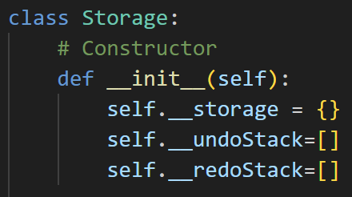
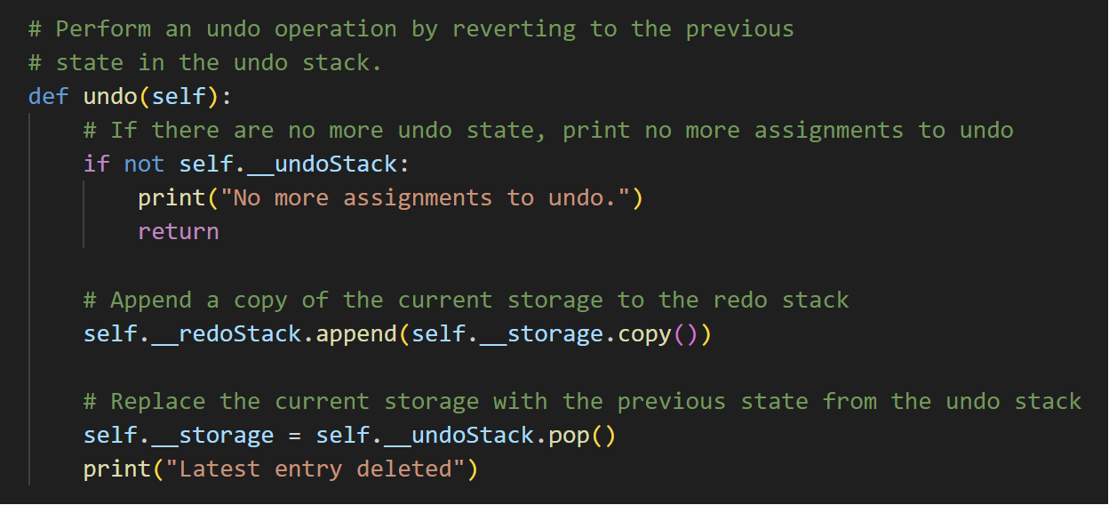
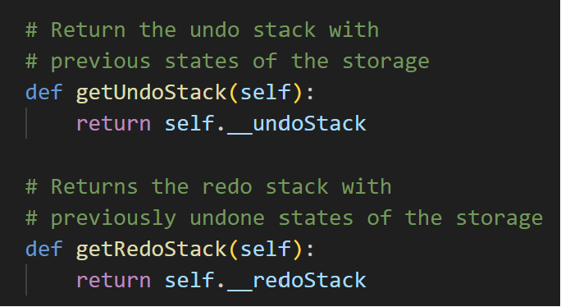
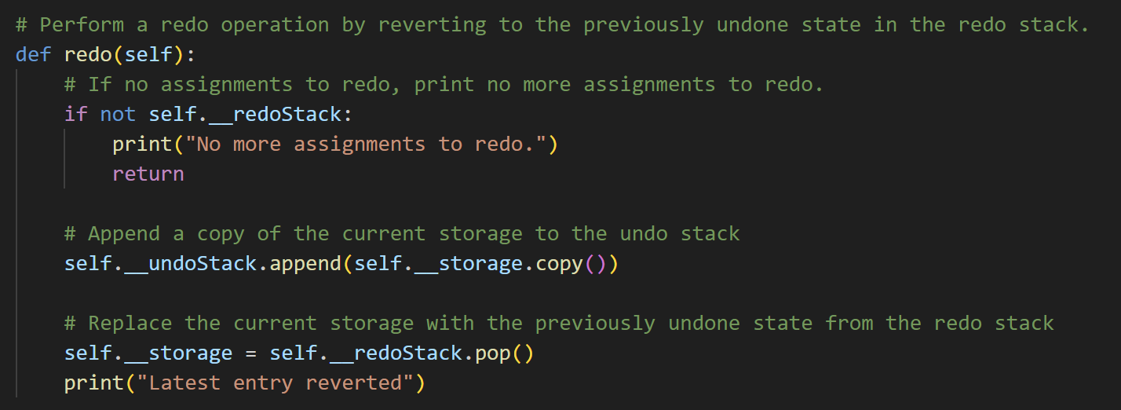
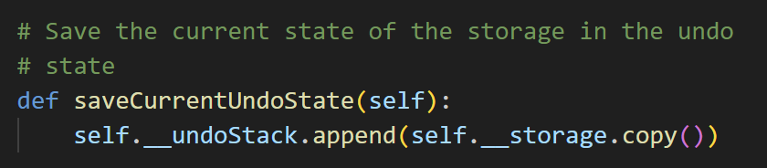
Additional Feature 1 (Redo & Undo Assignments)
Last in first out principal was used to manage the undo and redo actions effectively
The undo function allows user to delete the most recently added assignment. This is useful when users makes a mistake when assigning an entry.
First, it checks if there is any assignments to undo, then saves for a redo before deleting the latest entry.
Getters to obtain the undo and redo stack states of the storage
Save current undo state and append the current storage into the undo stack.
The redo function allows user to restore the assignments to the most recent undone state, effectively reversing the ‘undo’ statement.
First, it checks if there is any assignments to redo, then saves for an undo before restoring the latest changes made

Slide 5
Additional Feature 1 (Redo & Undo Assignments)
Technical Sophistication: Additional feature 1 involves careful state management and the use of data structure Stacks (Last-In-First-Out) to record the history of the user’s action.
For example, when user undo a statement, the state is appended into the undo stack and the latest state is saved when an undo command is issued. Hence, employing to the LIFO principal.
By capturing the entire state of assignments before each change, the application is able to revert to any previous state.
Uniqueness: Ability to undo and redo complex sequences of mathematical assignments without manually having to restart the program.
Innovativeness: The nature and fun of math is about realising your errors and backtracking and exploring alternate calculations. This feature will allow user for more experimentations which fosters a more productive standpoint.
Usability: From a usability standpoint, the undo and redo function significantly improves the user interface. Users can easily correct their errors when assigning an entry thus making the application more user friendly.

Slide 6
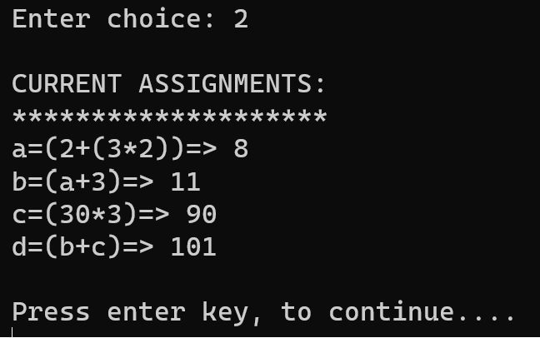
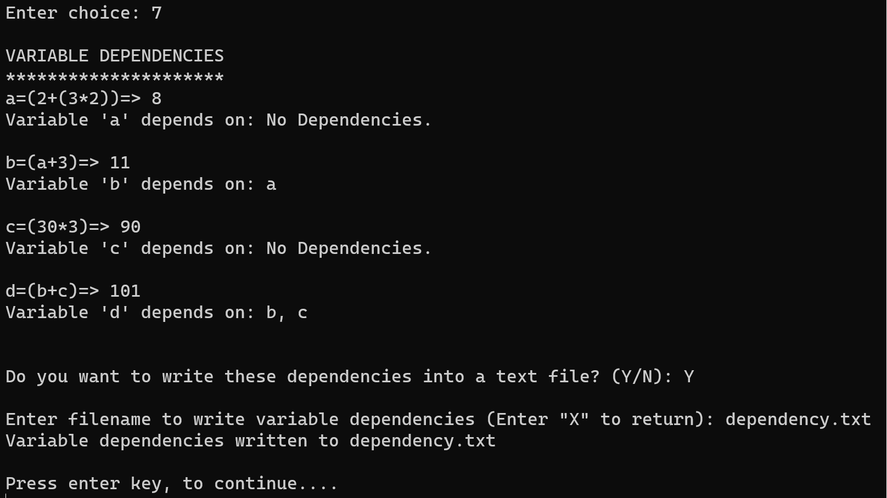
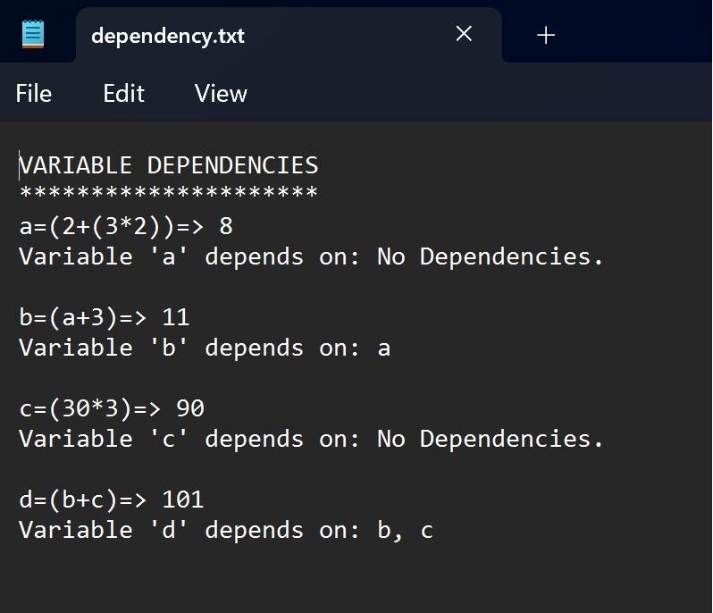
Additional Feature 2 ( Show Variable Dependencies)
The ‘Show Variable Dependencies’ feature allows users to analyze and display the dependencies for all their assignment statements. This allows for more in depth understanding as to how the different variables are interconnected to one another.
Users can also choose to save the variable dependency output as a text file for further analysis.
This is useful in scenarios where the equations are too complex or there is too many assignments which makes it challenging to manually track the dependencies.

Slide 7
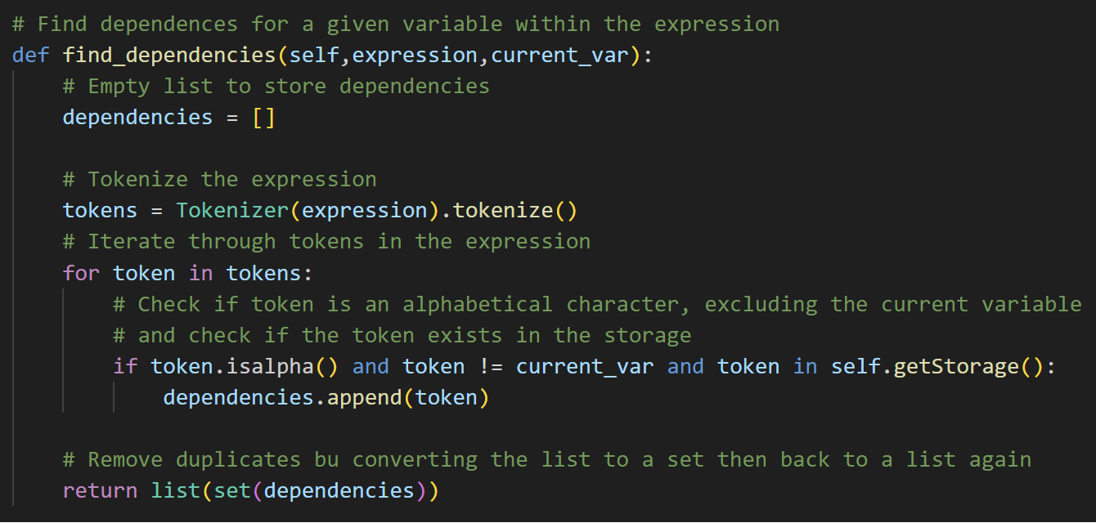
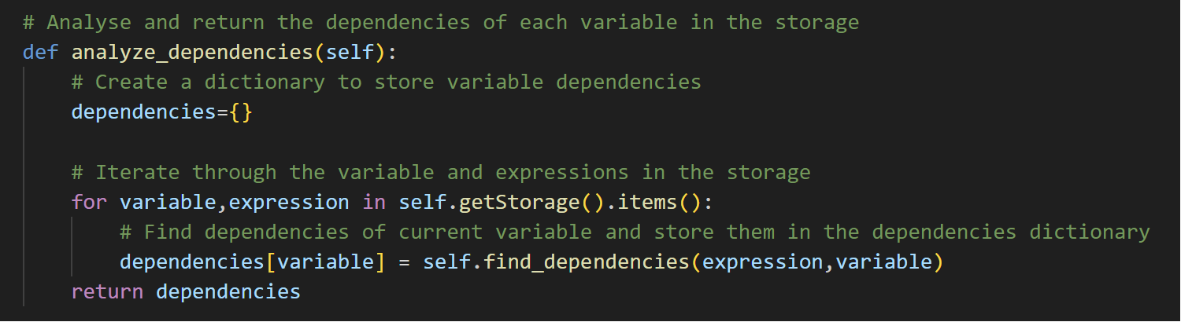
Additional Feature 2 (Show Variable Dependencies)
The find_dependencies function helps to identify a given variable’s dependency.
Tokenize the given expression
Identify the dependencies by checking if the token is alphabetic, is not the current variable and exists within the storage.
Remove duplicate dependencies by making it a set before converting it back to a list again.
Return the dependency for the given variable
The analyze_dependencies function iterates through every variable and its expression in the storage. It calls the find_dependencies function for each variable to identify that specific variable’s dependency.

Slide 8
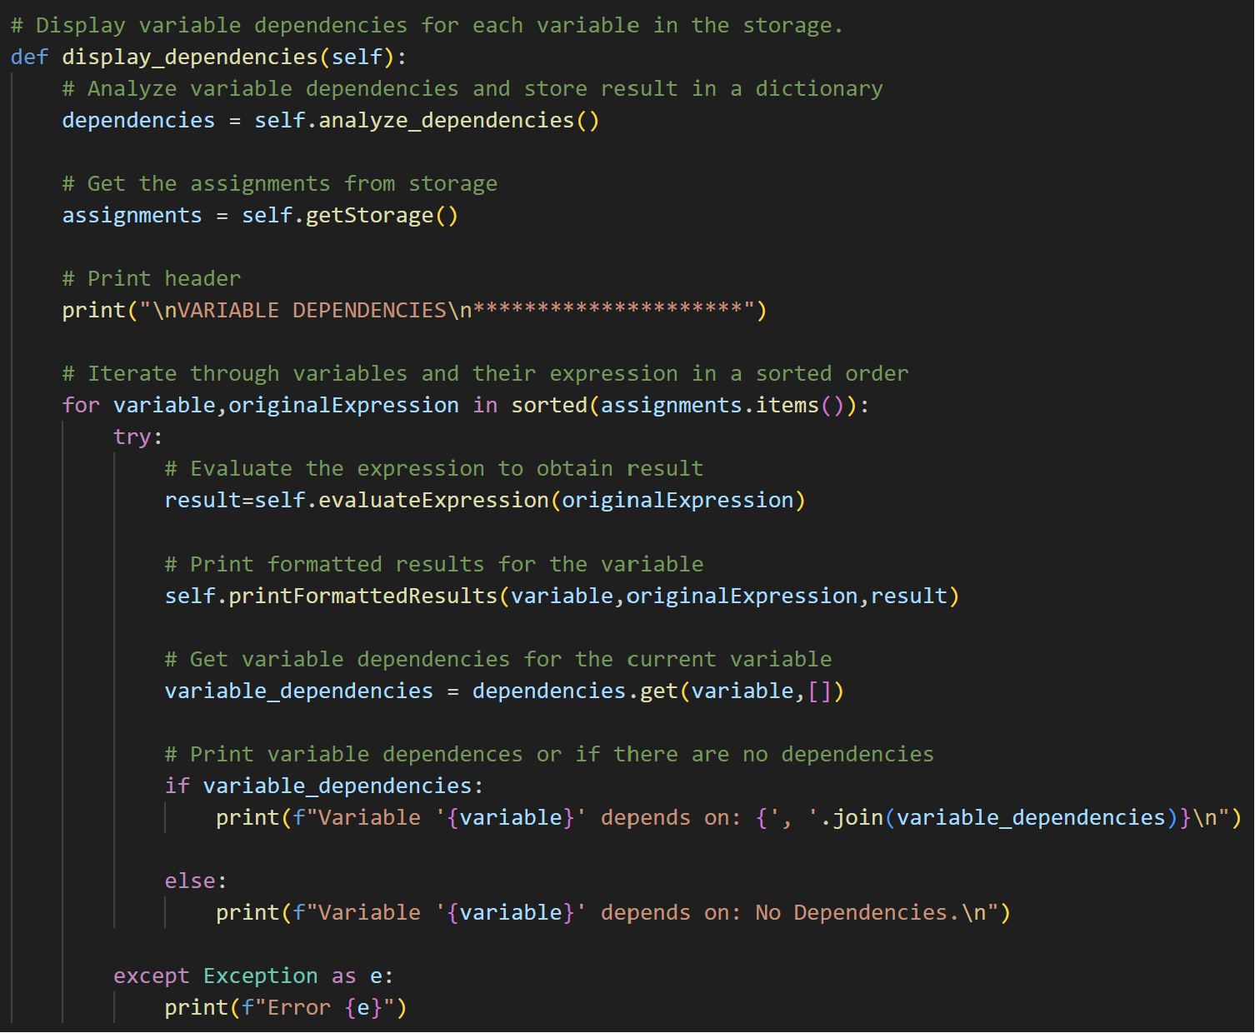
Additional Feature 2 (Show Variable Dependencies)
Technical Sophistication: Efficiently managing and updating dependencies when each assignment changes. Sets has also been used to remove duplicate dependencies which optimises speed.
Uniqueness: This feature has real-time dependency tracking. The user is able to track every dependency immediately after assigning statements. Not only that, the user can also choose to save the variable dependency information in a text file for further analysis
Innovativeness: This feature can serve as an educational tool for others to gain more insights about the assignments, visualize and understanding the interrelationships between different variable
Usability: This feature can be useful in situations where the assignments are way too complex or the number of assignments being handled are too many. Not only that, the ability to write the variable dependencies into a file that can further be used for further analysis and reports
The display_dependencies function formats the expression, results and their given dependency and presents the information for users to visualize.

